Slide 1
Planning a conference in Toronto

Slide 2
Requirements
Hotels for residence
Meeting halls (preferably inside hotels)
Restaurants
Cafes
Landmarks
To wind down/relax after a hard day

Slide 3
How to proceed?
Foursquare application to get latitudes and longitudes for the city.
Get dataframe :
Hotels, landmarks, restaurants, shopping stores, cafes
Clean dataframe
Use of clustering to understand best options
Map generation to see final results

Slide 4
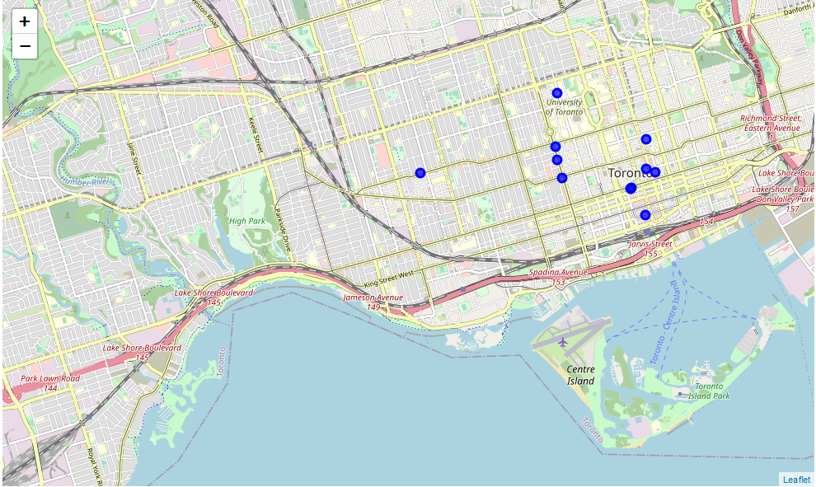
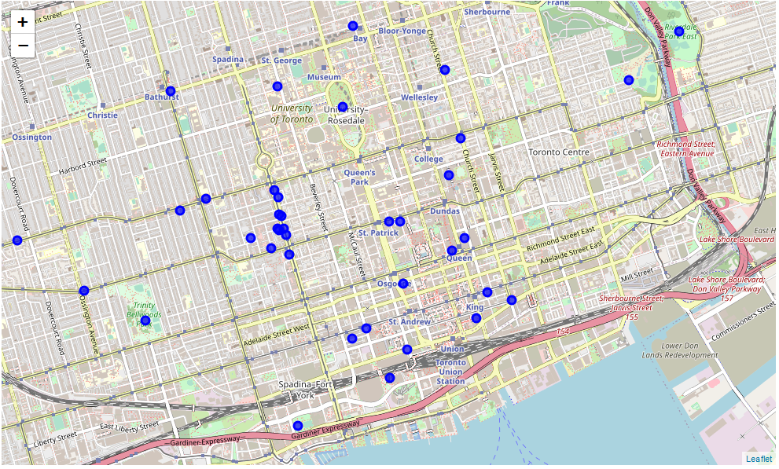
results

